Slide 1
Distance and Displacement

Slide 2
Lesson Objective
By the end of this lesson you will be able to explain the terms Displacement and Distance.

Slide 3
Review
30 seconds think time
What is the definition instantaneous speed?
What is velocity?

Slide 4
Planning a trip?
When planning a trip around Australia what do you need to consider??
You would need to consider the distance, or how far away places to visit are.
You would also need to consider the amount of time you have.
In this case, distance would be measured in kilometers, and your time in days or weeks.
If considering a trip to the end of your street, what would distance be measured in?
And the time?

Slide 5
Calculating distance
The formula for average speed can be rearranged to calculate the distance travelled in a certain time as:
distance = average speed × time
or s=v×t

Slide 6
Calculating distance
Work out the following:
Trinh rides her bike with a constant speed of 5 m/s. It takes her 3 minutes to get to the milk bar. Calculate how far away it is.
While Trinh is riding, a toddler runs onto the road ahead. If Trinh took 0.5 second to react, how far does she travel before hitting the brakes?

Slide 7
Solution A
First, convert the time she took into seconds in order to state the answer in metres.
t = 3 × 60 = 180 s
Trinh has travelled: s=v×t
= 5 × 180
= 900 m The milk bar is 900 m away.

Slide 8
Solution B
s=v×t
= 5 × 0.5
= 2.5 m
Trinh travels 2.5 m before hitting the brakes. She will then travel further as she slows to a stop.

Slide 9
You also need to consider where you will end your journey.
Your displacement is straight-line distance between the finishing and starting points.
If you travel from home to the house of a friend who lives 200 km south, then your displacement is 200 km south.
Displacement specifies not only the distance from the starting point, but also the direction of the end point from your starting point.

Slide 10
Distance is a scalar quantity—it has a size but not direction.
Displacement is a vector quantity—it has both a size and direction.
If travelling on a return trip, you can cover a large distance, but your displacement upon returning home is zero.

Slide 11
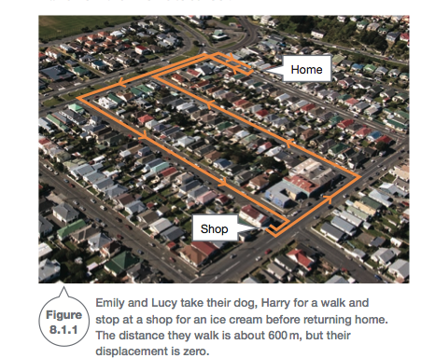
Figure 8.1.1 illustrates a journey that covers a certain distance, but the displacement is zero

Slide 12
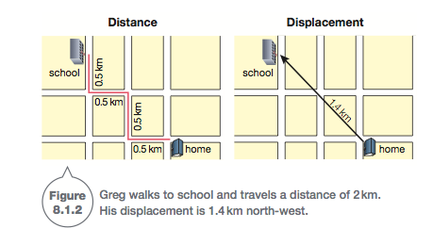
Figure 8.1.2 compares the distance travelled with the displacement of a student who walks from their home to school.

Slide 13
Recall
30 seconds think time
What is the definition of distance and displacement?

